Slide 1
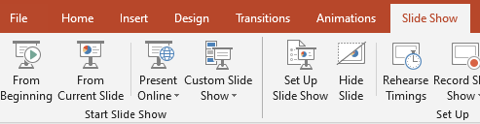
Click on the Blue Button Every time, on each sheet to see the animations
Play the PPT from the beginning. Go-to Slideshow → from beginning.

Slide 2
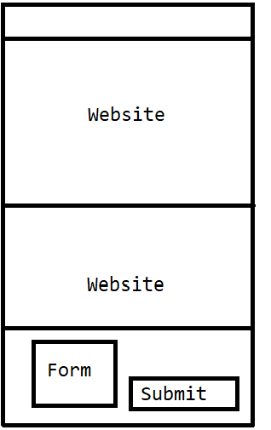

User goes to the website
Data is stored in Database
Data from form
Submit

Slide 3
Page 2 - Users Navigates to the second page
Get Movies
Using the URL: https://code-slam.herokuapp.com/movies
Sr | Name | Description | Tags
1 | ……. | ……. | …….
2 | ……. | ……. | …….

Slide 4
Page 2 - Create Model
Create Model
Random Forest
Decision Tree
A model will be created on the server using any on algorithm (random forest or decision tree)
This will be created on the Django service running on the server, which you have just set up.
You have to just connect to the service.
Refer to the documentation for the address of the service.

Slide 5
Page 3 - Prediction
<Movie Name>
Action, Comedy, Horror
<Movie Description>
Predict Tags

Slide 6


Follow the instructions in the PDF. Install the below given packages
Use version 1.1.0 (in PDF)
Use version 3.6

Slide 7
More packages
SCIKIT-learn
SCIpy

Slide 8
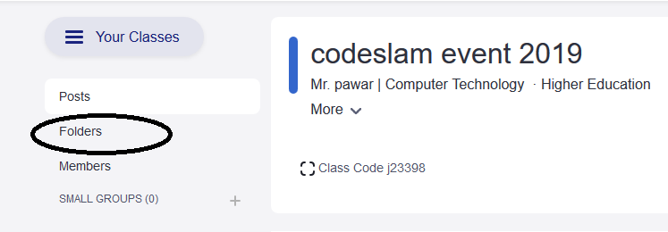
For ML Code, join this Edmodo group
https://edmo.do/j/q3i24y
Check the folders section and download those files

